Slide 1
Deadlock

Slide 2
The deadlock problem
Deadlock is a situation where a set of processes are blocked because each process is holding a resource and waiting for another resource acquired by some other process.
Consider an example when two trains are coming toward each other on same track and there is only one track, none of the trains can move once they are in front of each other.
Similar situation occurs in operating systems when there are two or more processes hold some resources and wait for resources held by other.

Slide 3
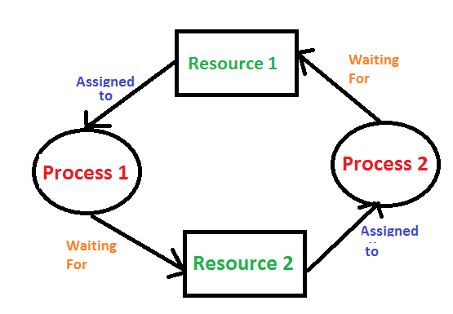
For example, in the below diagram, Process 1 is holding Resource 1 and waiting for resource 2 which is acquired by process 2, and process 2 is waiting for resource 1.

Slide 4
Deadlock characterization
Deadlock can arise if following four conditions hold simultaneously
Mutual Exclusion: One or more than one resource are non-sharable (Only one process can use at a time)
Hold and Wait: A process is holding at least one resource and waiting for resources.
No Preemption: A resource cannot be taken from a process unless the process releases the resource.
Circular Wait: A set of processes are waiting for each other in circular form.

Slide 5
Methods for handling deadlocks
Prevention
Ensure that the system will never enter a deadlock state
Avoidance
Ensure that the system will never enter an unsafe state
Detection
Allow the system to enter a deadlock state and then recover
Do Nothing
Ignore the problem and let the user or system administrator respond to the problem; used by most operating systems, including Windows and UNIX

Slide 6
Deadlock Prevention
If we can be able to violate one of the four necessary conditions and don't let them occur together then we can prevent the deadlock.
Let's see how we can prevent each of the conditions:

Slide 7
Mutual Exclusion
Mutual section from the resource point of view is the fact that a resource can never be used by more than one process simultaneously which is fair enough but that is the main reason behind the deadlock. If a resource could have been used by more than one process at the same time then the process would have never been waiting for any resource.
However, if we will be able to violate resources behaving in the mutually exclusive manner then the deadlock can be prevented.

Slide 8
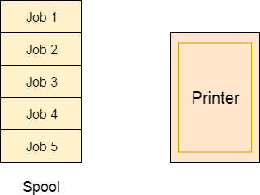
Spooling
For a device like printer, spooling can work. There is a memory associated with the printer which stores jobs from each of the process into it.
Later, Printer collects all the jobs and print each one of them according to FCFS.
By using this mechanism, the process doesn't have to wait for the printer and it can continue whatever it was doing.
Later, it collects the output when it is produced.

Slide 9
Hold and wait
we must guarantee that whenever a process requests a resource, it does not hold any other resources
Require a process to request and be allocated all its resources before it begins execution, or allow a process to request resources only when the process has none
Result: Low resource utilization; starvation possible

Slide 10
No preemption
If a process that is holding some resources requests another resource that cannot be immediately allocated to it, then all resources currently being held are released
Preempted resources are added to the list of resources for which the process is waiting
A process will be restarted only when it can regain its old resources, as well as the new ones that it is requesting

Slide 11
Circular Wait
To violate circular wait, we can assign a priority number to each of the resource. A process can't request for a lesser priority resource. This ensures that not a single process can request a resource which is being utilized by some other process and no cycle will be formed.
Each resource will be assigned with a numerical number. A process can request for the resources only in increasing order of numbering. For Example, if P1 process is allocated R5 resources, now next time if P1 ask for R4, R3 lesser than R5 such request will not be granted, only request for resources more than R5 will be granted.

Slide 12
Deadlock Avoidance
In deadlock avoidance, the request for any resource will be granted if the resulting state of the system doesn't cause deadlock in the system.
The state of the system will continuously be checked for safe and unsafe states.
In order to avoid deadlocks, the process must tell OS, the maximum number of resources a process can request to complete its execution.
The simplest and most useful approach states that the process should declare the maximum number of resources of each type it may ever need.
The Deadlock avoidance algorithm examines the resource allocations so that there can never be a circular wait condition.

Slide 13
Safe state
When a process requests an available resource, the system must decide if immediate allocation leaves the system in a safe state
A system is in a safe state only if there exists a safe sequence
A sequence of processes <P₁, P₂, …, P_{n}> is a safe sequence for the current allocation state if, for each P_{i}, the resource requests that P_{i} can still make, can be satisfied by currently available resources plus resources held by all P_{j}, with j < i.
That is:
If the P_{i} resource needs are not immediately available, then P_{i} can wait until all P_{j} have finished
When P_{j} is finished, P_{i} can obtain needed resources, execute, return allocated resources, and terminate
When P_{i} terminates, P_{i +1} can obtain its needed resources, and so on

Slide 14
If a system is in safe state ⇒ no deadlocks
If a system is in unsafe state ⇒ possibility of deadlock
Avoidance ⇒ ensure that a system will never enter an unsafe state

Slide 15
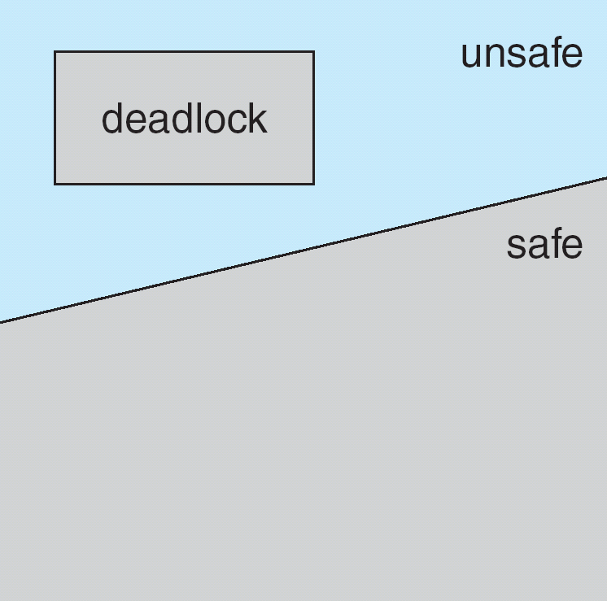
Safe, unsafe and deadlock state

Slide 16
Avoidance algorithms
Resource allocation graph
Banker’s algorithm

Slide 17
Resource allocation graph
As its name suggests, the resource allocation graph is the complete information about all the processes which are holding some resources or waiting for some resources.
It also contains the information about all the instances of all the resources whether they are available or being used by the processes.
In Resource allocation graph, the process is represented by a Circle while the Resource is represented by a rectangle.

Slide 18
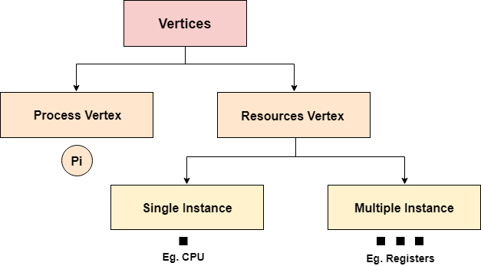
Vertices are mainly of two types, Resource and process. Each of them will be represented by a different shape. Circle represents process while rectangle represents resource.
A resource can have more than one instance. Each instance will be represented by a dot inside the rectangle.

Slide 19
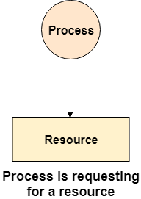
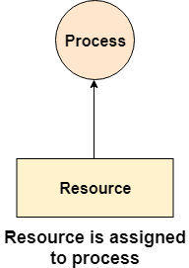
Edges in RAG are also of two types, one represents assignment and other represents the wait of a process for a resource.

Slide 20
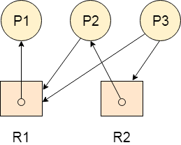
Example
Let's consider 3 processes P1, P2 and P3, and two types of resources R1 and R2. The resources are having 1 instance each.
According to the graph, R1 is being used by P1, P2 is holding R2 and waiting for R1, P3 is waiting for R1 as well as R2.
The graph is deadlock free since no cycle is being formed in the graph.

Slide 21
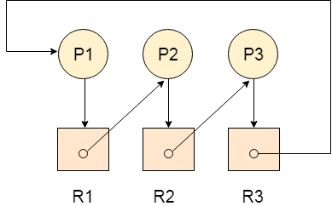
Deadlock Detection using RAG
If a cycle is being formed in a Resource allocation graph where all the resources have the single instance then the system is deadlocked.
The following example contains three processes P1, P2, P3 and three resources R1, R2, R3. All the resources are having single instances each.
If we analyze the graph then we can find out that there is a cycle formed in the graph since the system is satisfying all the four conditions of deadlock.

Slide 22
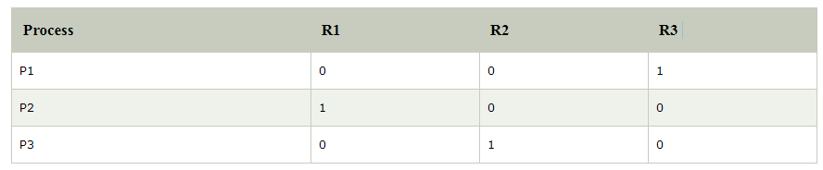
Allocation Matrix
Allocation matrix can be formed by using the Resource allocation graph of a system. In Allocation matrix, an entry will be made for each of the resource assigned.

Slide 23
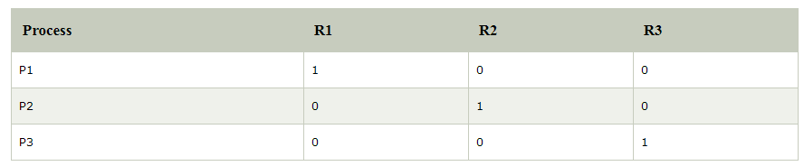
Request Matrix
In request matrix, an entry will be made for each of the resource requested.
Avial = (0,0,0)
Neither we are having any resource available in the system nor a process going to release. Each of the process needs at least single resource to complete therefore they will continuously be holding each one of them.
We cannot fulfill the demand of at least one process using the available resources therefore the system is deadlocked as determined earlier when we detected a cycle in the graph.

Slide 24
Resource-Allocation Graph (Cont.)‏
Process
Resource Type with 4 instances
P_{i} requests instance of R_{j}
P_{i} is holding an instance of R_{j}
P_{i}
R_{j}
P_{i}
R_{j}

Slide 25
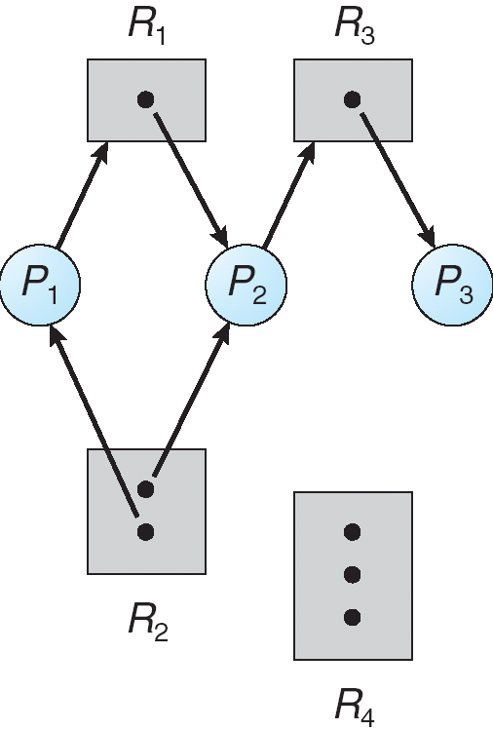
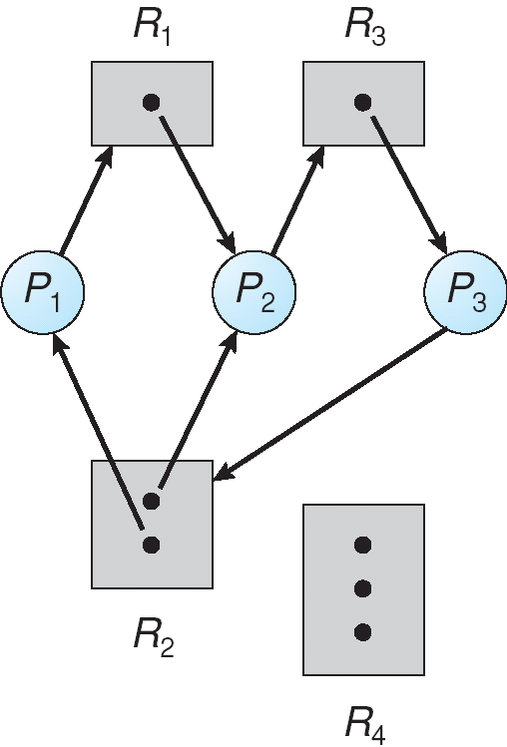
Resource Allocation Graph With A Deadlock
Before P₃ requested an instance of R₂
After P₃ requested an instance of R₂

Slide 26
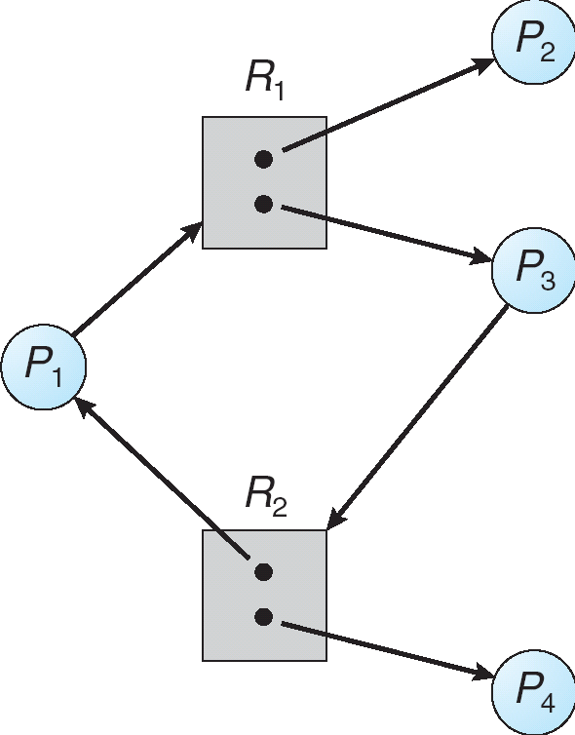
Graph With A Cycle But No Deadlock
Process P₄ may release its instance of resource type R₂. That
resource can then be allocated to P3, thereby breaking the cycle.

Slide 27
Relationship of cycles to deadlocks
If a resource allocation graph contains no cycles ⇒ no deadlock
If a resource allocation graph contains a cycle and if only one instance exists per resource type ⇒ deadlock
If a resource allocation graph contains a cycle and if several instances exists per resource type ⇒ possibility of deadlock

Slide 28
In order to recover the system from deadlocks, either OS considers resources or processes.
For Resource
Preempt the resource
We can snatch one of the resources from the owner of the resource (process) and give it to the other process with the expectation that it will complete the execution and will release this resource sooner. Well, choosing a resource which will be snatched is going to be a bit difficult.
Rollback to a safe state
System passes through various states to get into the deadlock state. The operating system can rollback the system to the previous safe state. For this purpose, OS needs to implement check pointing at every state.
The moment, we get into deadlock, we will rollback all the allocations to get into the previous safe state.

Slide 29
For Process
Kill a process
Killing a process can solve our problem but the bigger concern is to decide which process to kill. Generally, Operating system kills a process which has done least amount of work until now.
Kill all process
This is not a suggestible approach but can be implemented if the problem becomes very serious. Killing all process will lead to inefficiency in the system because all the processes will execute again from starting.

Slide 30
Banker’s Algorithm
The banker’s algorithm is a resource allocation and deadlock avoidance algorithm.
Let ‘n’ be the number of processes in the system and ‘m’ be the number of resources types.
Allocation_{i} specifies the resources currently allocated to process P_{i} and Need_{i} specifies the additional resources that process P_{i} may still request to complete its task.
Banker’s algorithm consist of Safety algorithm and Resource request algorithm

Slide 31
Safety Algorithm
The algorithm for finding out whether or not a system is in a safe state can be described as follows:
1) Let Work and Finish be vectors of length ‘m’ and ‘n’ respectively. Initialize: Work = Available Finish[i] = false; for i=1, 2, 3, 4….n
2) Find an i such that both a) Finish[i] = false b) Need_{i} <= Work if no such i exists goto step (4)
3) Work = Work + Allocation[i] Finish[i] = true goto step (2)
4) if Finish [i] = true for all i then the system is in a safe state

Slide 32
Resource-Request Algorithm
Let Request_{i} be the request array for process P_{i}. Request_{i} [j] = k means process P_{i} wants k instances of resource type R_{j}. When a request for resources is made by process P_{i}, the following actions are taken:
1) If Request_{i} <= Need_{i} Goto step (2) ; otherwise, raise an error condition, since the process has exceeded its maximum claim.
2) If Request_{i} <= Available Goto step (3); otherwise, P_{i} must wait, since the resources are not available.
3) Have the system pretend to have allocated the requested resources to process Pi by modifying the state as follows: Available = Available – Requesti Allocation_{i} = Allocation_{i} + Request_{i} Need_{i} = Need_{i}– Request_{i}

Slide 33
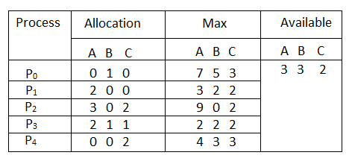
Example: Considering a system with five processes P₀ through P₄ and three resources types A, B, C. Resource type A has 10 instances, B has 5 instances and type C has 7 instances. Suppose at time t₀ following snapshot of the system has been taken:

Slide 34
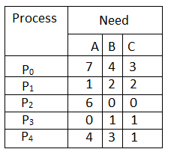
Question1. What will be the content of the Need matrix?
Need [i, j] = Max [i, j] – Allocation [i, j]
So, the content of Need Matrix is:

Slide 35
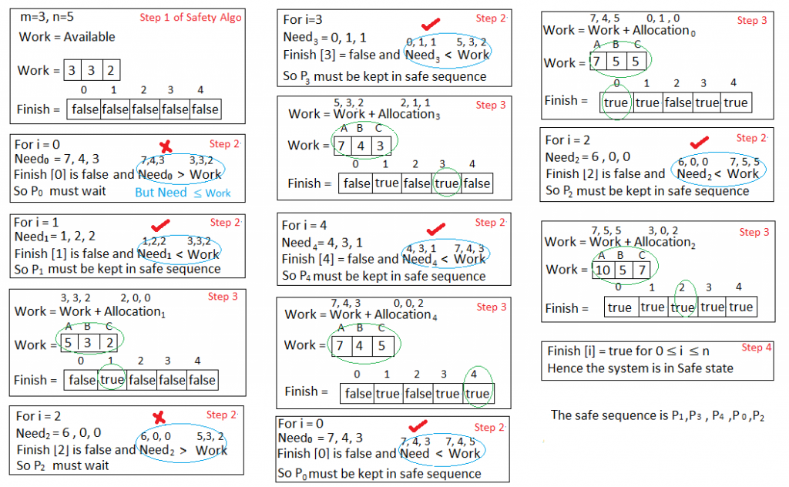
Question2. Is the system in safe state? If Yes, then what is the safe sequence?

Slide 36
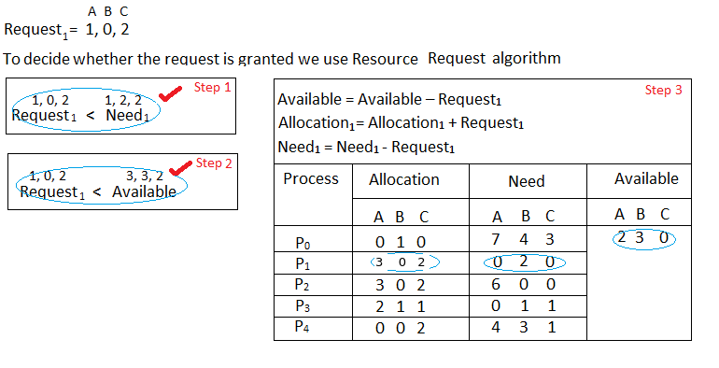
Question3. What will happen if process P₁ requests one additional instance of resource type A and two instances of resource type C?

Slide 37
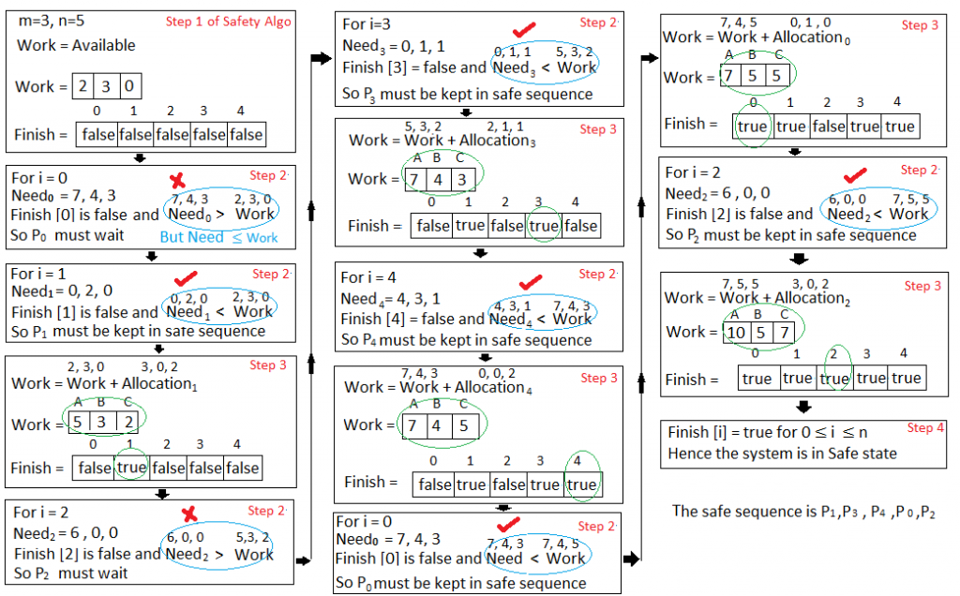

Slide 38
What if P4 requests (3,3,0)?
P0 requests (0,2,0)?

Slide 39
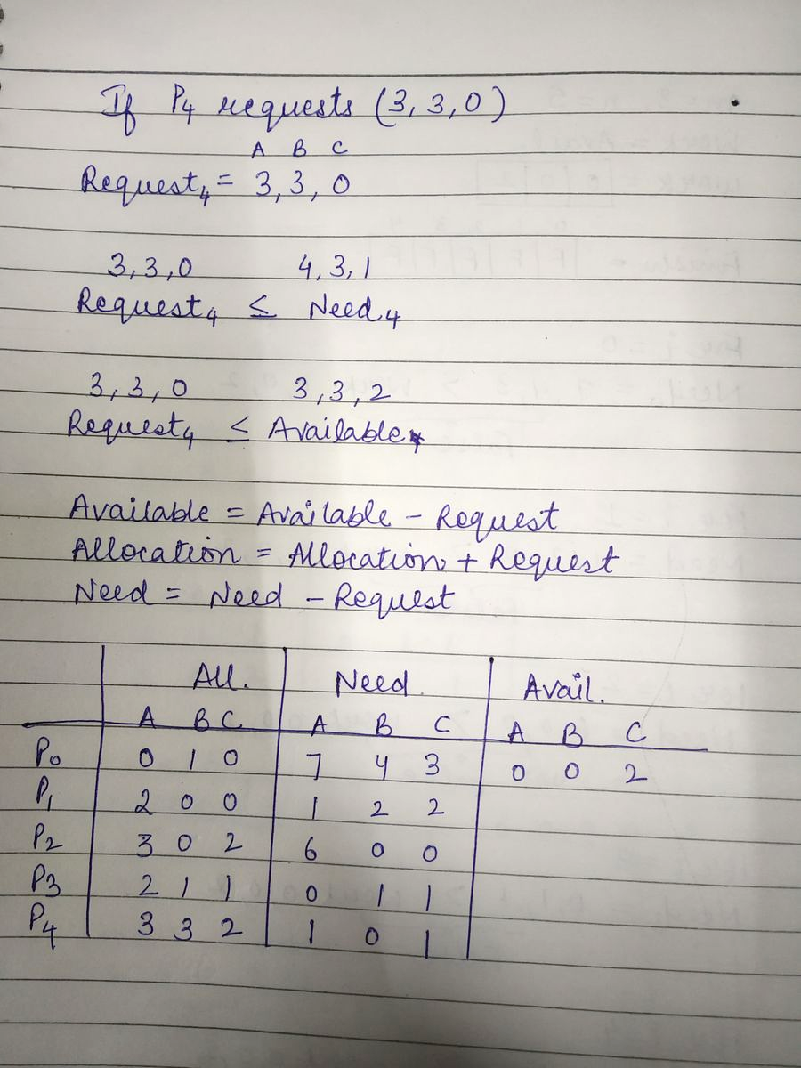

Slide 40
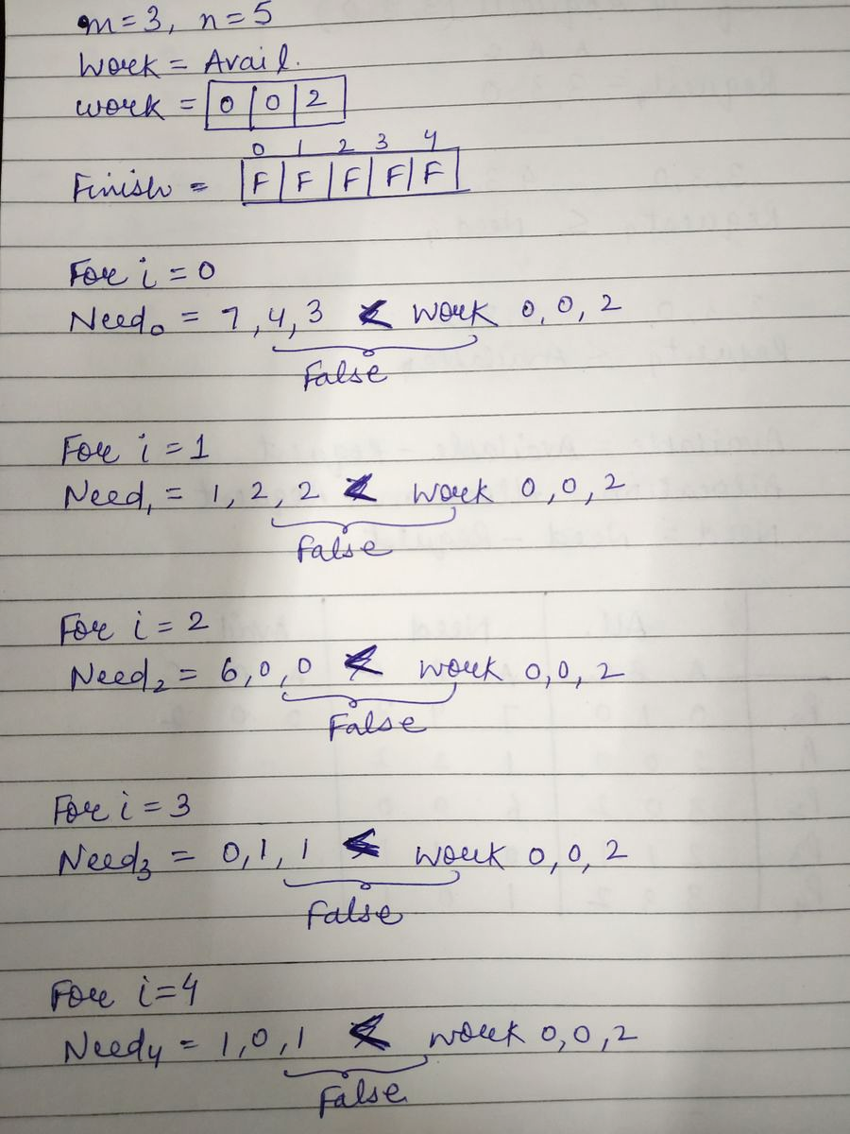

Slide 41
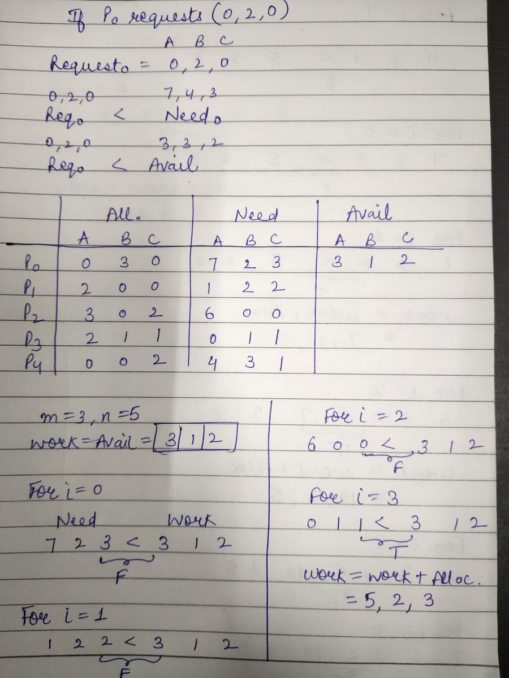

Slide 42
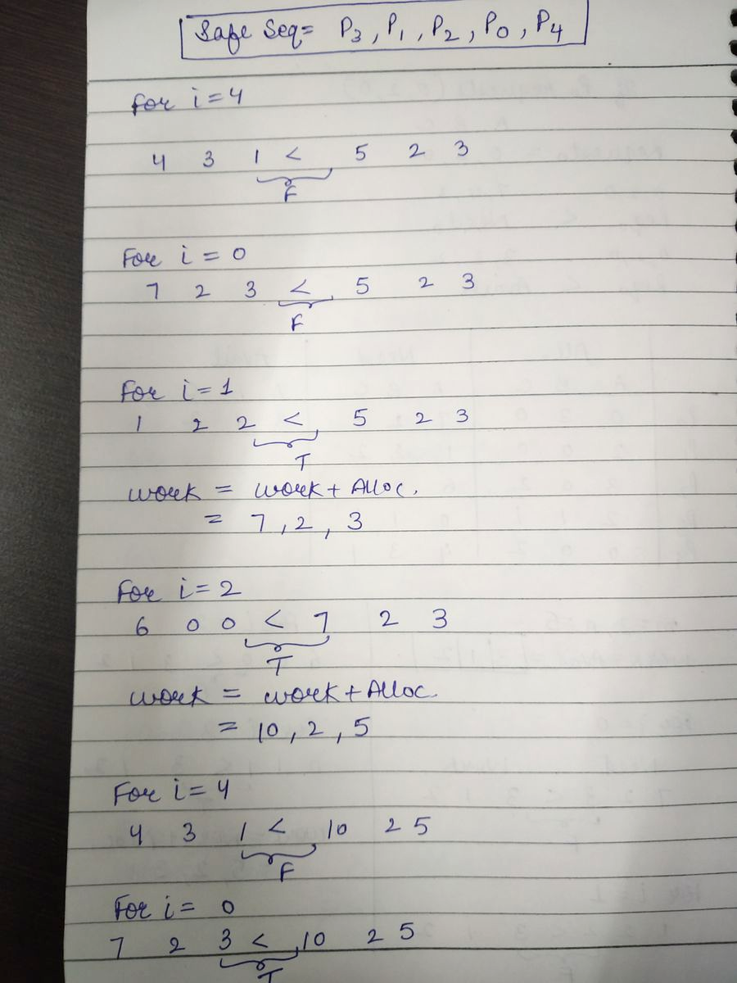

Slide 43
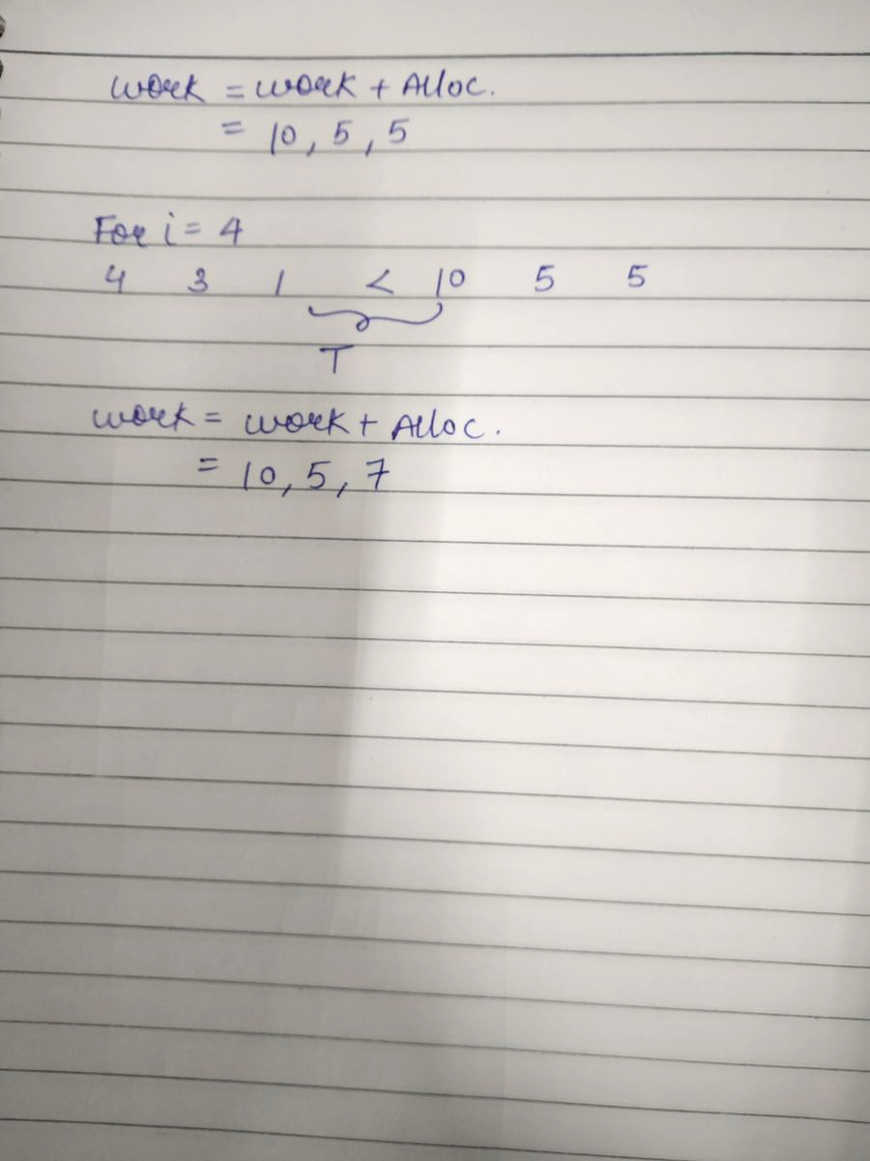

Slide 44
Deadlock Detection
Allow system to enter deadlock state
Detection algorithm
Recovery scheme

Slide 45
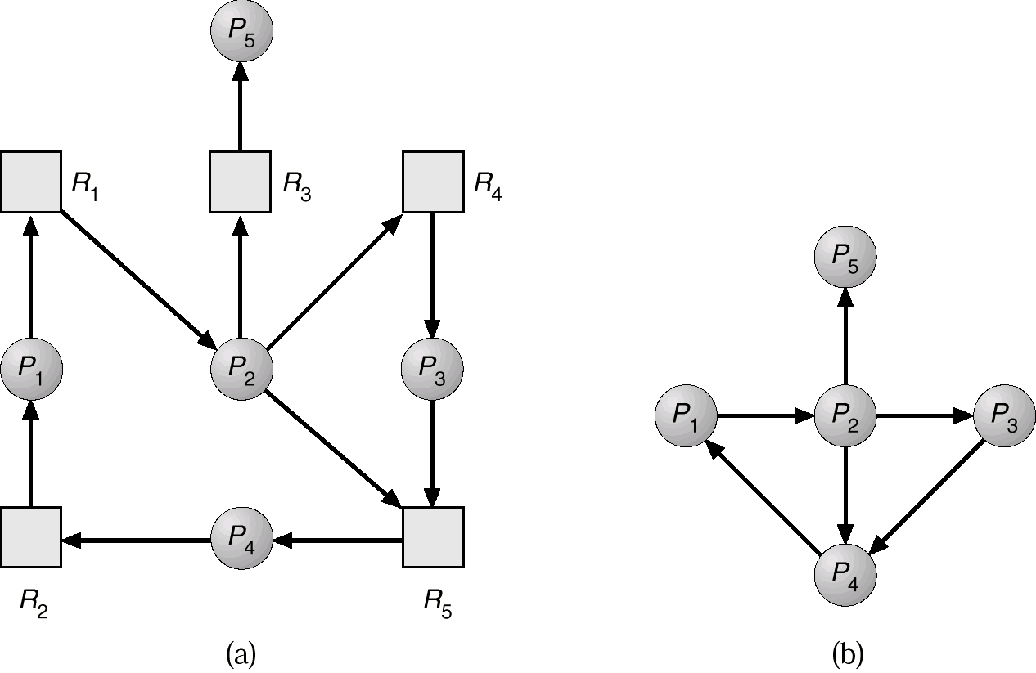
Resource-Allocation Graph And Wait-for Graph
Resource-Allocation Graph
Corresponding wait-for graph

Slide 46
Detection Algorithm
1. Let Work and Finish be vectors of length m and n, respectively Initialize:
(a) Work :- Available
(b) For i = 1,2, …, n, if Allocation_{i} ≠ 0, then Finish[i] := false;otherwise, Finish[i] := true.
2. Find an index i such that both:
(a) Finish[i] = false
(b) Request_{i} ≤ Work
If no such i exists, go to step 4.
3. Work := Work + Allocation_{i} Finish[i] := true go to step 2.
4. If Finish[i] = false, for some i, 1 ≤ i ≤ n, then the system is in deadlock state. Moreover, if Finish[i] = false, then P_{i} is deadlocked.

Slide 47
Example of Detection Algorithm
Five processes P₀ through P₄; three resource types A (7 instances), B (2 instances), and C (6 instances).
Snapshot at time T₀:
Allocation Request Available
A B C A B C A B C
P₀ 0 1 0 0 0 0 0 0 0
P₁ 2 0 0 2 0 2
P₂ 3 0 3 0 0 0
P₃ 2 1 1 1 0 0
P₄ 0 0 2 0 0 2
Sequence <P₀, P₂, P₃, P₄, P₁> will result in Finish[i] = true for all i.

Slide 48
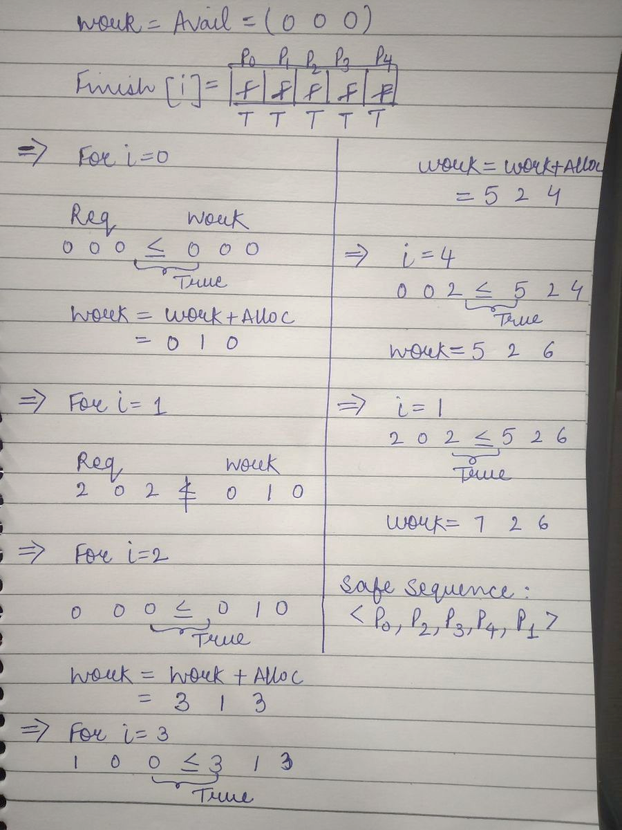

Slide 49
Example (Cont.)
P₂ requests an additional instance of type C.
Request
A B C
P₀ 0 0 0
P₁ 2 0 2
P₂ 0 0 1
P₃ 1 0 0
P₄ 0 0 2
State of system?
Can reclaim resources held by process P₀, but insufficient resources to fulfill other processes; requests.
Deadlock exists, consisting of processes P₁, P₂, P₃, and P₄.

Slide 50
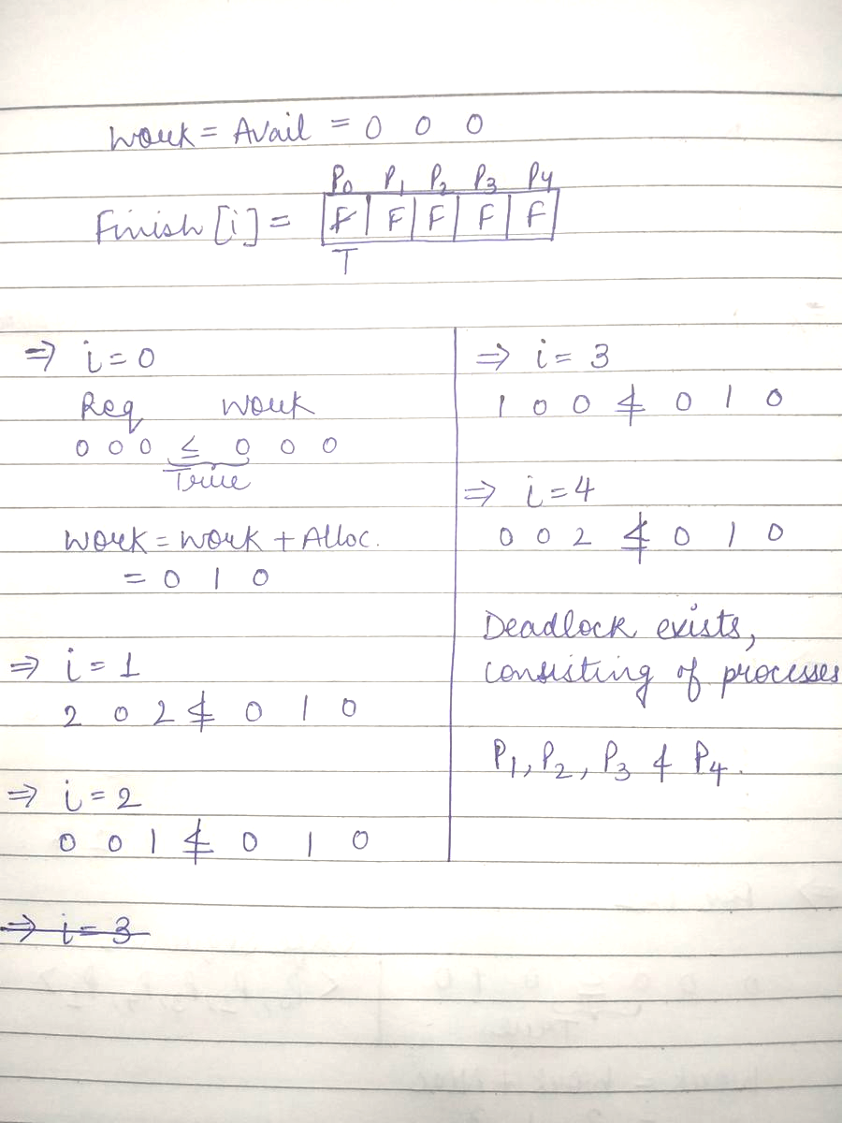

Slide 51
Recovery from Deadlock: Process Termination
Abort all deadlocked processes.
Abort one process at a time until the deadlock cycle is eliminated.
In which order should we choose to abort?
Priority of the process.
How long process has computed, and how much longer to completion.
Resources the process has used.
Resources process needs to complete.
How many processes will need to be terminated.
Is process interactive or batch?

Slide 52
Recovery from Deadlock: Resource Preemption
Selecting a victim – minimize cost.
Rollback – return to some safe state, restart process fro that state.
Starvation – same process may always be picked as victim, include number of rollback in cost factor.

